Slide 1
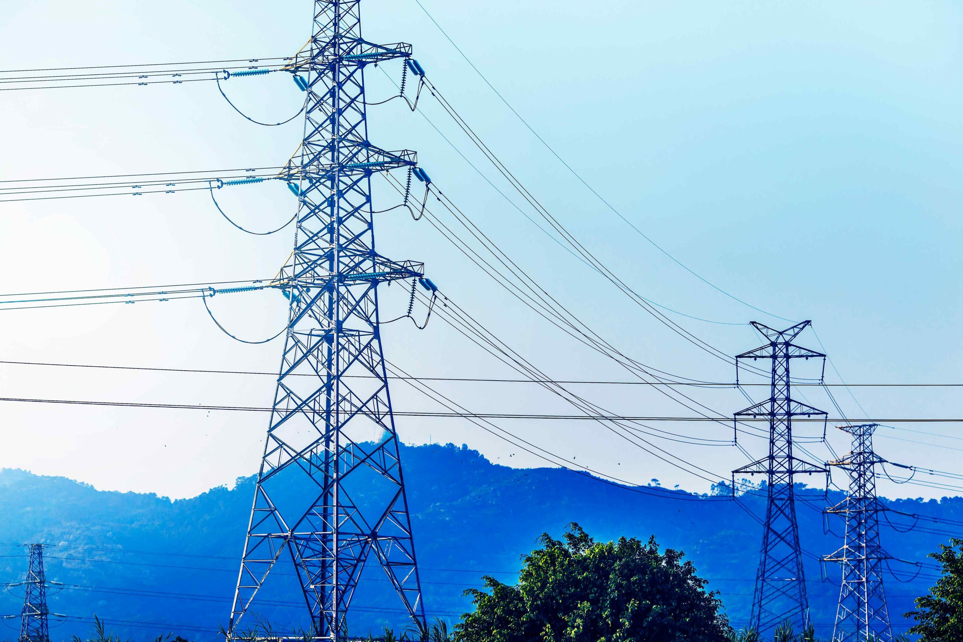
ELECTRIC POWER TRANSMISSION ENHANCEMENT
A Case of Nigerian Electric Power Grid

Slide 2
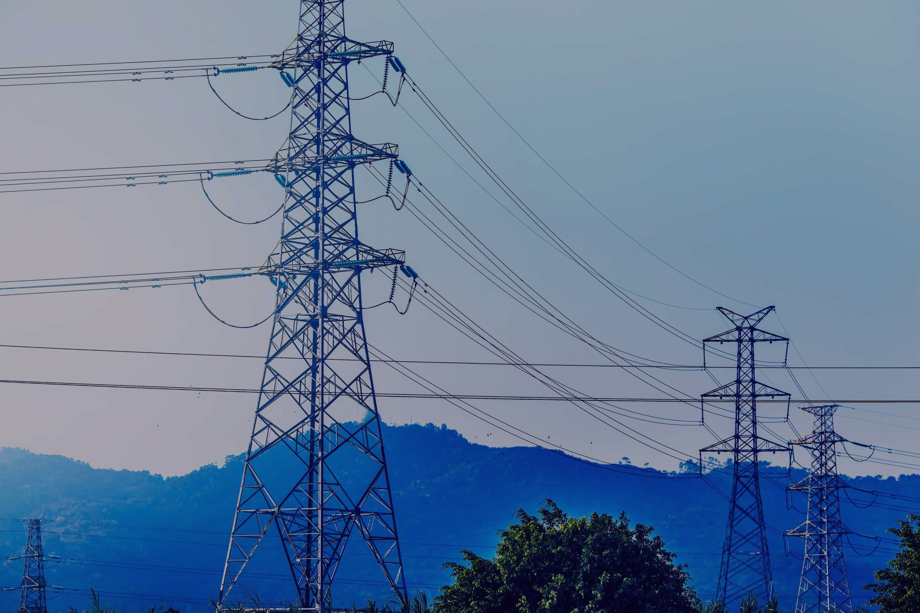
CONTENT
Introduction
Transmission Line Performance
Nigerian 330kv Power Grid; A Test Case
Observation and Discussion
Conclusion
References

Slide 3
INTRODUCTION
Increase in Demand
Economic activities and population growth have led to an increase in electrical energy demands
Overutilization of Energy
Overutilization of the transmission system has resulted in power quality reduction and limitations in power transmission.

Slide 4
OBJECTIVES
Modeling Transmission Lines
Enhancing Transmission Capabilities
Analyzing Model Strengths and Weaknesses
Assessing Enhancement Impacts
Improving Asset Management

Slide 5
TRANSMISSION SYSTEMS ENHANCEMENT STRATEGIES
Installation of New Transmission Line.
Reconductoring Transmission Line/Terminal Equipment Replacements.
Conversion from single circuit to double circuit.
Voltage Upgrade.
Reactive Power Compensation.
Phase Shifting.

Slide 6
NIGERIAN TEST CASE ON 330KV
The Nigerian 330kV power grid faces problems like poor voltage, insufficient power, and frequent breakdowns.
It cannot transmit the current power demand and would struggle even more with increased demand.
Evaluating specific transmission lines is essential to improve performance and meet growing electricity needs.
"Voltage upgrade" strategy implemented in Nigeria's transmission system.

Slide 7
OBSERVATION
Effect of Increase in Voltage Level
Higher voltage boosts line loadability, asset utilization, and stability limits.
Open-Line Characteristics
No-load voltage may surpass limits for longer lines, requiring shunt reactors for regulation.
Line’s Voltage Profile
Increasing sending power decreased receiving voltage, causing violation, highlighting line capacity limits and inefficiencies.
Effect of Line Reconductoring
Reconductoring transmission line increases thermal capacity, not affecting voltage stability.

Slide 8
CONCLUSION
The lines in the 330KV transmission network are not limited by stability limits and thermal limits.
Reconductoring, as a power grid strengthening strategy, may not yield a reasonable improvement on the grid
Though transmission at Ultra High Voltage (UHV) levels can create rooms for more power evacuation.
The power grid should be fortified with voltage control equipment

Slide 9
REFERENCES
E. U. Oleka, S. N. Ndubisi, and G. K. Ijemaru, “Electric Power Transmission Enhancement: A case of nigerian electric power grid,” American Journal of Electrical and Electronic Engineering, http://pubs.sciepub.com/ajeee/4/1/5/ (accessed Apr. 5, 2024).

Slide 10
THANK YOU
PRESENTED BY
KAILASH DUSAD -- 22110112
MONU SUNIA -- 22110155
CHANCHAL YADAV -- 22110055

